Slide 1
Exceptions

Slide 2
exceptions
Exception Handling in Java is one of the effective ways to handle runtime errors so that the regular flow of the application can be preserved. Java Exception Handling is a mechanism to handle runtime errors such as ClassNotFoundException, IOException, SQLException, RemoteException, etc.
What are Java Exceptions?
In Java, Exception is an unwanted or unexpected event, which occurs during the execution of a program, i.e. at run time, that disrupts the normal flow of the program’s instructions. Exceptions can be caught and handled by the program. When an exception occurs within a method, it creates an object. This object is called the exception object. It contains information about the exception, such as the name and description of the exception and the state of the program when the exception occurred.

Slide 3
exceptions
Major reasons why an exception Occurs
Invalid user input
Device failure
Loss of network connection
Physical limitations (out-of-disk memory)
Code errors
Opening an unavailable file
Errors represent irrecoverable conditions such as Java virtual machine (JVM) running out of memory, memory leaks, stack overflow errors, library incompatibility, infinite recursion, etc. Errors are usually beyond the control of the programmer, and we should not try to handle errors.
Difference between Error and Exception
Error: An Error indicates a serious problem that a reasonable application should not try to catch.
Exception: Exception indicates conditions that a reasonable application might try to catch

Slide 4
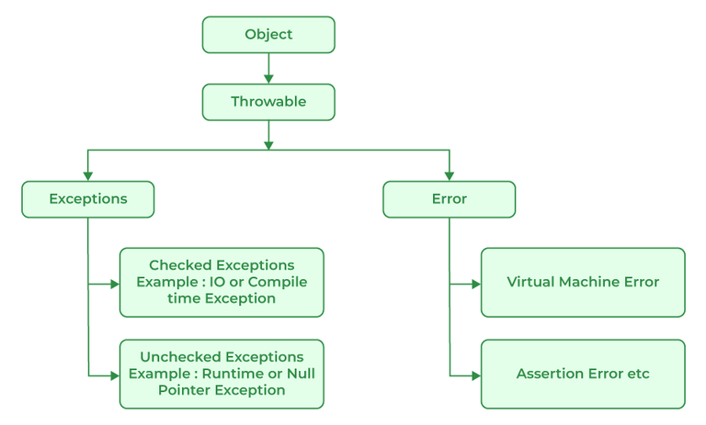
exceptions
Exception Hierarchy
All exception and error types are subclasses of the class Throwable, which is the base class of the hierarchy. One branch is headed by Exception. This class is used for exceptional conditions that user programs should catch. NullPointerException is an example of such an exception. Another branch, Error is used by the Java run-time system(JVM) to indicate errors having to do with the run-time environment itself(JRE). StackOverflowError is an example of such an error.

Slide 5
exceptions
Exception Hierarchy

Slide 6
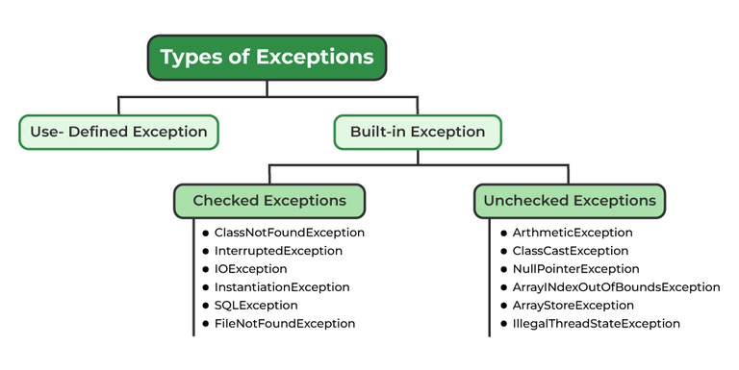
exceptions
Types of Exceptions
Java defines several types of exceptions that relate to its various class libraries. Java also allows users to define their own exceptions.

Slide 7
exceptions
Exceptions can be categorized in two ways:
1. Built-in Exceptions
Checked Exception
Unchecked Exception
2. User-Defined Exceptions
1. Built-in Exceptions
Built-in exceptions are the exceptions that are available in Java libraries. These exceptions are suitable to explain certain error situations.
Checked Exceptions: Checked exceptions are called compile-time exceptions because these exceptions are checked at compile-time by the compiler.
Unchecked Exceptions: The unchecked exceptions are just opposite to the checked exceptions. The compiler will not check these exceptions at compile time. In simple words, if a program throws an unchecked exception, and even if we didn’t handle or declare it, the program would not give a compilation error.

Slide 8
exceptions
2. User-Defined Exceptions:
Sometimes, the built-in exceptions in Java are not able to describe a certain situation. In such cases, users can also create exceptions, which are called ‘user-defined Exceptions’.
The advantages of Exception Handling in Java are as follows:
Provision to Complete Program Execution
Easy Identification of Program Code and Error-Handling Code
Propagation of Errors
Meaningful Error Reporting
Identifying Error Types

Slide 9
Exceptions
1. printStackTrace()
This method prints exception information in the format of the Name of the exception: description of the exception, stack trace.
2. toString()
The toString() method prints exception information in the format of the Name of the exception: description of the exception.
3. getMessage()
The getMessage() method prints only the description of the exception.

Slide 10
Exceptions
How Programmer Handle an Exception?
Customized Exception Handling: Java exception handling is managed via five keywords: try, catch, throw, throws, and finally. Briefly, here is how they work. Program statements that you think can raise exceptions are contained within a try block. If an exception occurs within the try block, it is thrown. Your code can catch this exception (using catch block) and handle it in some rational manner. System-generated exceptions are automatically thrown by the Java run-time system. To manually throw an exception, use the keyword throw. Any exception that is thrown out of a method must be specified as such by a throws clause. Any code that absolutely must be executed after a try block completes is put in a finally block.
try {
// Block of code to try
}
catch(Exception e) {
// Block of code to handle errors
}

Slide 11
Exceptions
Finally
The finally statement lets you execute code, after try...catch, regardless of the result:
The throw keyword
The throw statement allows you to create a custom error.
The throw statement is used together with an exception type. There are many exception types available in Java: ArithmeticException, FileNotFoundException, ArrayIndexOutOfBoundsException, SecurityException, etc:
if(name!=null){
throw new Exception();
}

Slide 12
Exceptions
Java throws
throws is a keyword in Java that is used in the signature of a method to indicate that this method might throw one of the listed type exceptions. The caller to these methods must handle the exception using a try-catch block.
In a program, if there is a chance of raising an exception then the compiler always warns us about it and compulsorily, we should handle that checked exception, Otherwise, we will get compile time error saying unreported exception XXX must be caught or declared to be thrown. To prevent this compile time error we can handle the exception in two ways:
By using try catch
By using the throws keyword

Slide 13
Exceptions
Java provides us the facility to create our own exceptions which are basically derived classes of Exception. Creating our own Exception is known as a custom exception or user-defined exception. Basically, Java custom exceptions are used to customize the exception according to user needs. In simple words, we can say that a User-Defined Exception or custom exception is creating your own exception class and throwing that exception using the ‘throw’ keyword.
For example, MyException in the below code extends the Exception class.
Why use custom exceptions?
Java exceptions cover almost all the general types of exceptions that may occur in the programming. However, we sometimes need to create custom exceptions.
Following are a few of the reasons to use custom exceptions:
To catch and provide specific treatment to a subset of existing Java exceptions.
Business logic exceptions: These are the exceptions related to business logic and workflow. It is useful for the application users or the developers to understand the exact problem.
In order to create a custom exception, we need to extend the Exception class that belongs to java.lang package.
Example: We pass the string to the constructor of the superclass- Exception which is obtained using the “getMessage()” function on the object created.

Slide 14
Exceptions
class MyException extends Exception {
public MyException(String s)
{
// Call constructor of parent Exception
super(s);
}
}

Slide 15
File IO
Java I/O (Input and Output) is used to process the input and produce the output.
Java uses the concept of a stream to make I/O operation fast. The java.io package contains all the classes required for input and output operations.
We can perform file handling in Java by Java I/O API.

Slide 16
File IO
File handling is an important part of any application.
Java has several methods for creating, reading, updating, and deleting files.
Java File Handling
The File class from the java.io package, allows us to work with files.
To use the File class, create an object of the class, and specify the filename or directory name:
try {
File myObj = new File("filename.txt");
if (myObj.createNewFile()) {
System.out.println("File created: " + myObj.getName());
} else {
System.out.println("File already exists.");
}
} catch (IOException e) {
System.out.println("An error occurred.");
e.printStackTrace();

Slide 17
File IO
OutputStream class
OutputStream class is an abstract class. It is the superclass of all classes representing an output stream of bytes. An output stream accepts output bytes and sends them to file
Method | Description
1) public void write(int)throws IOException | is used to write a byte to the current output stream.
2) public void write(byte[])throws IOException | is used to write an array of byte to the current output stream.
3) public void flush()throws IOException | flushes the current output stream.
4) public void close()throws IOException | is used to close the current output stream.

Slide 18
File IO
OutputStream
Java application uses an output stream to write data to a destination; it may be a file, an array, peripheral device or socket.
InputStream
Java application uses an input stream to read data from a source; it may be a file, an array, peripheral device or socket.
FileOutputStream fout=new FileOutputStream("D:\\testout.txt");
String s="Welcome.";
byte b[]=s.getBytes();//converting string into byte array
fout.write(b);
fout.close();
System.out.println("success...");

Slide 19
File IO
InputStream class
InputStream class is an abstract class. It is the superclass of all classes representing an input stream of bytes.
Method | Description
1) public abstract int read()throws IOException | reads the next byte of data from the input stream. It returns -1 at the end of the file.
2) public int available()throws IOException | returns an estimate of the number of bytes that can be read from the current input stream.
3) public void close()throws IOException | is used to close the current input stream.

Slide 20
File IO
Java FileInputStream Class
Java FileInputStream class obtains input bytes from a file. It is used for reading byte-oriented data (streams of raw bytes) such as image data, audio, video etc. You can also read character-stream data. But, for reading streams of characters, it is recommended to use FileReader class
FileInputStream fin=new FileInputStream("D:\\testout.txt");
int i=0;
while((i=fin.read())!=-1){
System.out.print((char)i);
}
fin.close();

Slide 21

Thank you

